Slide 1
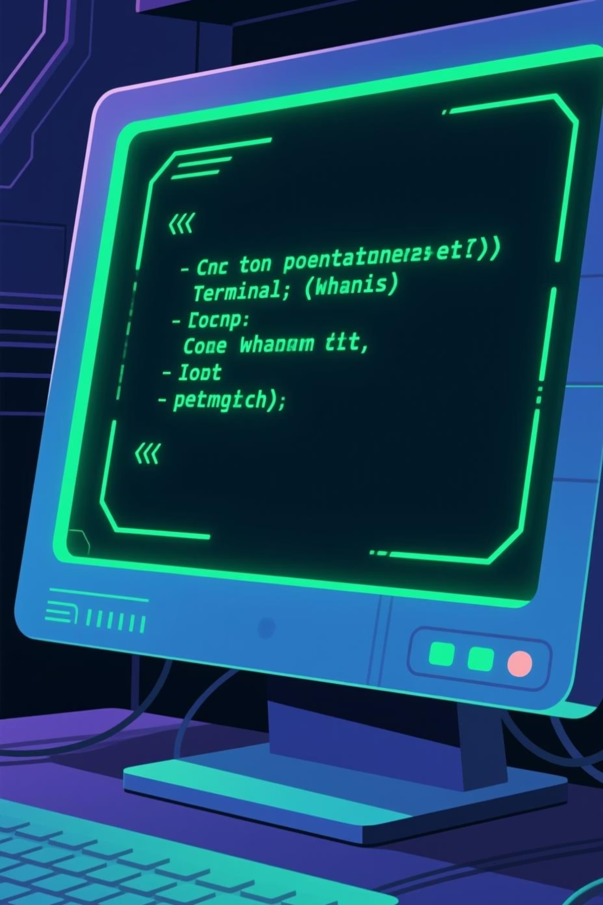


The Linux ls Command
Mastering File Listing
Exploring the simplest yet most powerful file listing tool in Linux — from basic directory navigation to advanced filtering techniques used by system administrators worldwide.

Slide 2
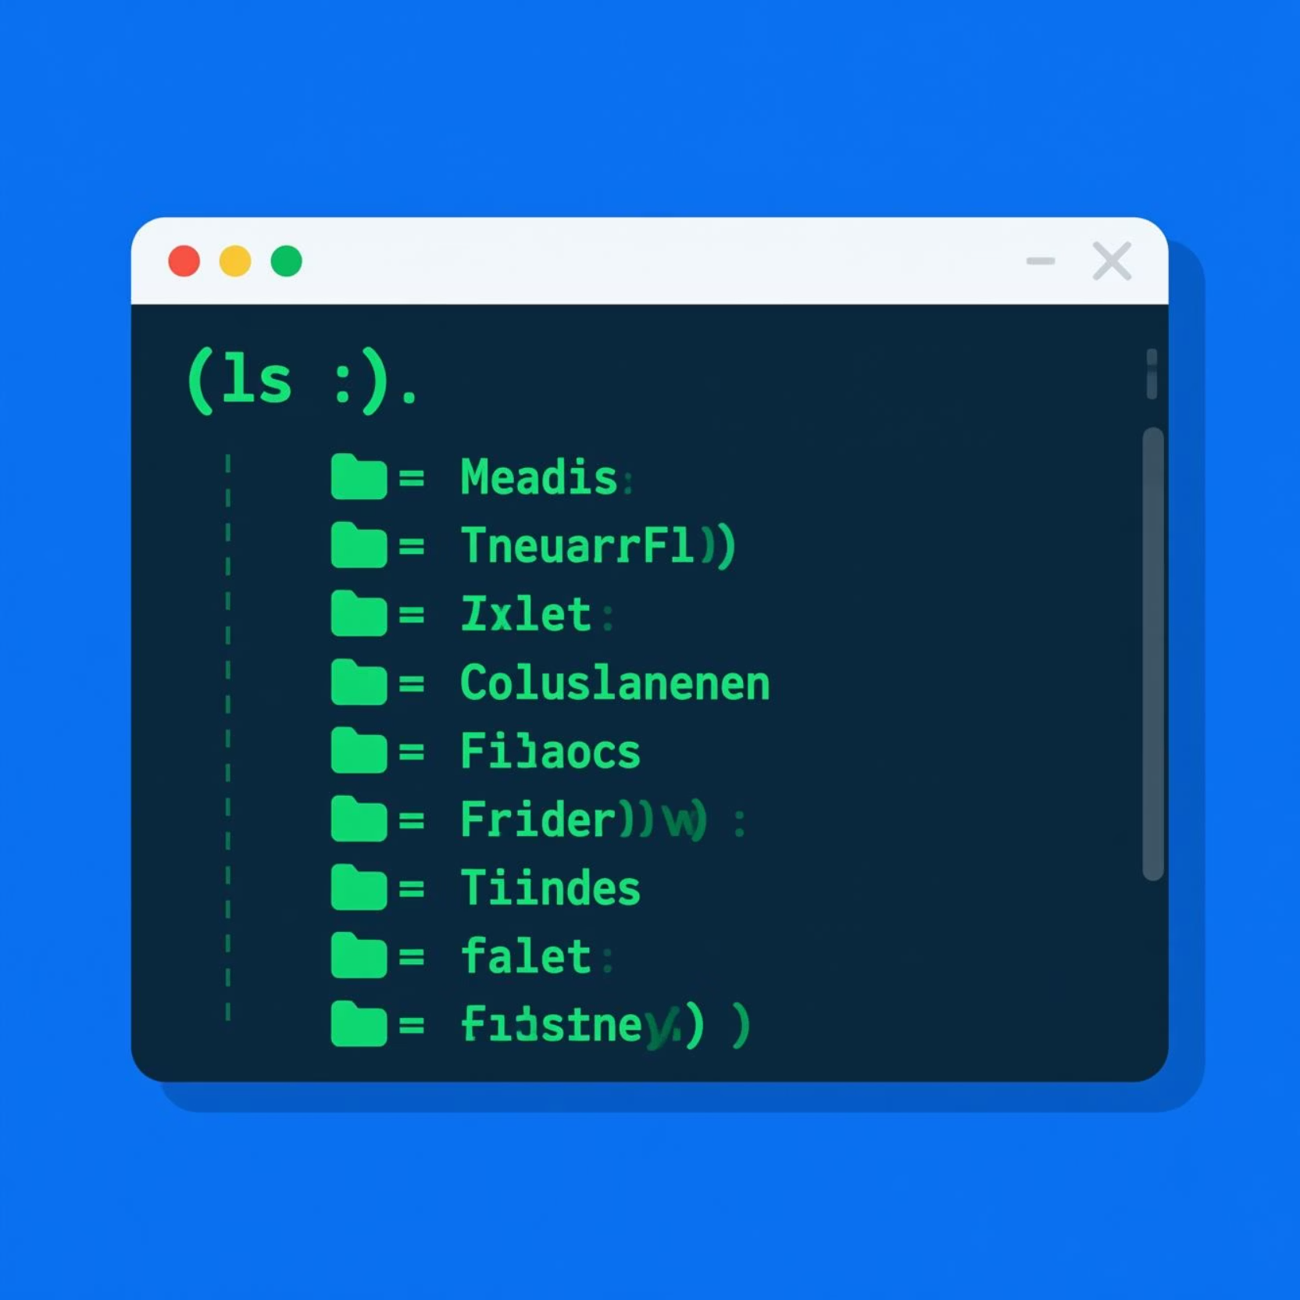


What is ls?
The Essential Command
ls stands for list — one of the most frequently used commands in Linux and Unix systems.
It displays all files and directories in your current working directory, providing essential information about your file system structure.
Every Linux user's journey begins here — it's the first step in exploring and understanding the file system.

Slide 3






Common ls Options & Their Powers
ls -a
ls -l
Show all files including hidden ones (starting with .)
Display long format with permissions, owner, size, and date
ls -lh
ls -t
Show file sizes in human-readable format (KB, MB, GB)
Sort files by modification time, newest first
💡 Pro Tip: Combine options like ls -lah to show all files in long format with readable sizes!

Slide 4




Decoding ls -l Output
Understanding each column of the long format listing unlocks powerful file system insights.
Permissions
Owner & Group
Size & Date
First 10 characters: file type and read/write/execute rights for owner, group, and others
Shows who owns the file and which group has access
File size in bytes (or human-readable with -h) and last modification timestamp

Slide 5


Real-World Applications
Why System Administrators Live By ls
File management: Quickly locate, verify, and organise files across complex directory structures
Troubleshooting: Check permissions, ownership, and timestamps when debugging access issues
Automation: Foundation for shell scripts that process files programmatically
Security audits: Identify suspicious files, permission changes, and hidden directories
From navigating simple home directories to managing enterprise servers — ls is the first command you learn and the last one you stop using.

Slide 6


$ echo "Thank You!"
Keep Exploring Linux
The ls command is just the beginning of your Linux journey. Master it, combine it with other tools like grep and find, and you'll navigate file systems like a pro.
01
02
03
Practise daily
Experiment
Go deeper
Use ls variations in real scenarios
Try combining multiple options
Explore man ls for advanced features

